Slide 1
COMMUNICATION SKILLS CLASS-I
SHUHITA BHATTACHARJEE

Slide 2
Class Slots
Tuesday: 12:00-1:30 pm [LHC13]
Wednesday: 12-1:30 pm [LHC13]
Friday: 12:00-1:30 [OFFICE HOURS]
Students are strongly advised to set up an appointment over email for one-on-one workshop/consultation during office hours.

Slide 3
Dates for Classes:
2 Sept, 3 Sept, 5 Sept (Holiday)
9 Sept, 10 Sept, 12 Sept (OfficeHrs: Consultation)
16 Sept 17 Sept (Mid-Sem Exam, LHC13) 19 Sept (OfficeHrs:Consultation)
23 Sept, 24 Sept 26 Sept (No Class: OfficeHrs)
14 Oct (End-Sem Exam, LHC13)

Slide 4
EVALUATION:
Mid-Term Exam (30% of the Final Grade)
Final Exam (70% of the Final Grade)

Slide 5
LA1760; LHC13
ahqonrwo
ahqonrwo
Google Classroom: Register and Follow for Content / Exam Submission
Class Code: ahqonrwo
Class Invite Link : https://classroom.google.com/c/Nzc1MjE1NTg1NTUz?cjc=ahqonrwo

Slide 6
Topics
Creative Reading: Video Texts
Genres of Professional Writing
Creative Reading: Poetry
Prevention of Workplace Language Discrimination
Social Media, Law, and Professionalism
Reporting and its Biases
Graphic Novels

Slide 7
Reading and Telling Stories
https://www.youtube.com/watch?v=LatobRtLukM

Slide 8
The Printed Rainbow
GITANJALI RAO

Slide 9
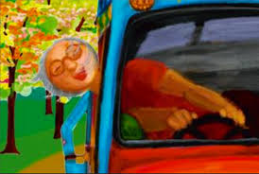
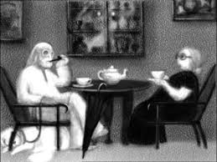
Plot
Tonality
Symbolism
Colour, Texture
Characterization
Animals
Humour
Ending of the Film
Representation of Old Age

